Slide 1


Ministry of Communications and Information Technology
Information Technology Institute
Information Technology Institute
Network Fundamentals
Local Area Networks

Slide 2
Transport Layer
UDP and TCP

Slide 3
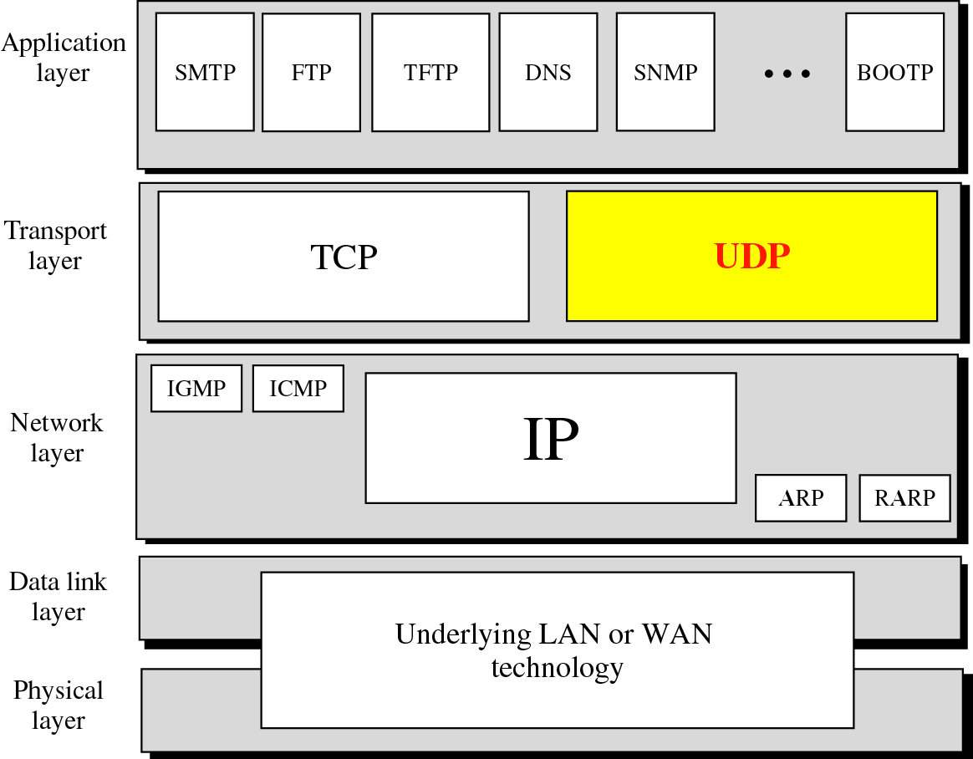

Slide 4
UDP
User Datagram Protocol
Transport layer protocol
Process to process communication
  Use port numbers
Connectionless
Unreliable
Perform very limited error checking
Very simple using a minimum of overhead

Slide 5
TCP
Transmission Control Protocol
Transport layer protocol
Process to process communication
Use port numbers
Reliable ( Use acknowledgements )
Connection oriented (Three way handshake)
Flow control (window size)

Slide 6
Port numbers
Well Known ports
  Range from 0 to 1,023
Registered ports
  Range from 1,024 to 49,151 not assigned or controlled by ICANN but can be registered at ICANN to avoid duplication
Dynamic ports
  Range from 49,152 to 65,535 are neither controlled nor registered

Slide 7
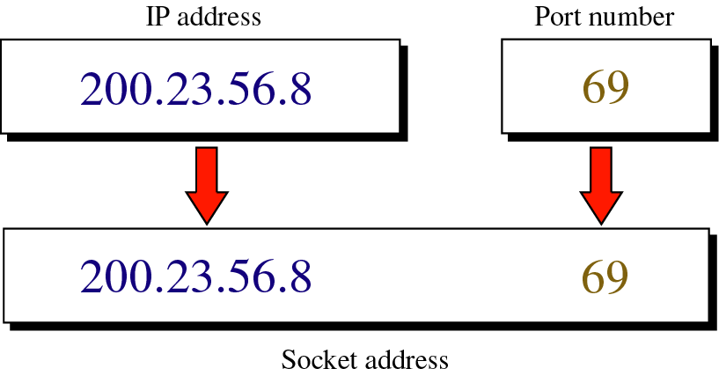
Socket Address

Slide 8
Network Communicating Protocols

Slide 9
The Need for Protocols
Protocols are needed for computer networks to communicate efficiently
Network protocols are set of rules that enable data to flow from one NIC to another
Protocols control the messages origination, the messages end, and the messages quantity in the network.

Slide 10
Major Networking Protocols
NetBEUI
IPX/SPX
TCP/IP
AppleTalk

Slide 11
NetBIOS
Network Basic Input/Output System.
A common network protocol that allows applications on different computers to communicate within a local area network (LAN).
It was created by IBM for its early PC Network, and was adopted by Microsoft.
It does not support a routing mechanism.
NetBIOS was later formalized in NetBEUI.

Slide 12
NetBEUI
NetBIOS Extended User Interface.
This is an enhanced version of the NetBIOS protocol used by network operating systems (NOS), such as Microsoft's Windows NT.
NetBEUI was developed by IBM for its LAN Manager product and has been adopted by Microsoft for its Windows NT, LAN Manager, and Windows for Workgroups products.
Non-routable

Slide 13
IPX/SPX
Internet Packet Exchange Sequenced Packet Exchange.
A communications protocol devised by Novell for Novell NetWare.
IPX/SPX packets can be routed from one network to another

Slide 14
IPX/SPX Advantages and Disadvantages
Advantages
  Ease of setup.
  Support for routing between networks.
  Speeds greater than TCP/IP for NT.
Disadvantages
  Slower than NetBEUI.
  IPX/SPX is not a vendor neutral

Slide 15
AppleTalk
AppleTalk is a set of local area network communication protocols originally created for Apple computers. An AppleTalk network can support up to 32 devices and data can be exchanged at a speed of 230.4 kilobits per second (Kbps).

Slide 16
TCP/IP
Transmission Control Protocol/Internet Protocol.
TCP/IP is open standard protocol
  Not tied to one vendor
TCP/IP is the internet protocol
Now internet use TCP/IP v4
Next version TCP/IP v6
It is the default protocol for
  Windows NT4
  Windows 2000
  UNIX
Notes:
IP represents the scheme by which two devices (both with IP addresses) communicate.
TCP manages the flow of IP packets, ensuring that the packets remain error-free and reach their destination correctly.

Slide 17
IEEE LAN Standards
IEEE: Institute of Electrical and Electronic Engineers
IEEE create standards for computer and communications
IEEE 802 series of standards for LAN technologies
IEEE defined several access methods
  CSMA/CD
  Token passing

Slide 18
Protocol Architecture
Lower layers of OSI model
IEEE 802 reference model
LAN layered protocol architecture
  Physical (topologies)
  Media access control
  Logical Link Control
All IEEE 802.x have the same LLC sublayer
MAC sublayer has very close relationship with the characteristics of physical medium and the topology of network

Slide 19
IEEE 802 versus OSI
Layer 7
Upper
Layers
Protocols
Layer 6
OSI
Reference
Model
IEEE 802
Reference Model
Layer 5
Layer 4
Layer 3
Data Link
Logic Link
Control
Media Access
Control
Scope of
IEEE 802
Standards
Physical
Physical

Slide 20
IEEE 802
802.1 Architecture and Internet
LLC
802.2 Logical Link Control
Data Link
Layer
802.3
Ethernet
802.4
Token Bus
802.11
Wireless
LAN
802.14
Cable
Modem
MAC
Physical Layer

Slide 21
Ethernet Technologies
The term Ethernet refers to the family of local-area network (LAN) products covered by the IEEE 802.3 standard that defines what is commonly known as the CSMA/CD protocol.
Data rates defined for operation over optical fiber and twisted-pair cables:
  10 Mbps—10Base-T Ethernet
  100 Mbps—Fast Ethernet
  1000 Mbps—Gigabit Ethernet
  10000Mbps—10Gigabit Ethernet

Slide 22
Half-Duplex Transmission — The CSMA/CD Access Method
The CSMA/CD protocol was originally developed as a means by which two or more stations could share a common media
It is used when the protocol does not require central arbitration, access tokens, or assigned time slots to indicate when a station will be allowed to transmit.
Each Ethernet MAC determines for itself when it will be allowed to send a frame.

Slide 23
CSMA/CD Access Rules
Carrier sense
  Each station continuously listens for traffic on the medium to determine when gaps between frame transmissions occur.
Multiple access
  Stations may begin transmitting any time they detect that the network is quiet (there is no traffic).
Collision detect
  This means that if any collision occurs, it will be detected immediately

Slide 24

The Basic Ethernet Bus
  Machine 2 wants to send a message to machine 4
  First it 'listens' to make sure no one else is using the network.
  If it is all clear it starts to transmit its data on to the network
  The signal moves down the cable and is received by every machine on the network but because it is only addressed to number 4, the other machines ignore it.
  Machine 4 then sends a message back to number 1 acknowledging receipt of the data

Slide 25
Collisions
  machine 2 and machine 5 both trying to transmit simultaneously.
  The resulting collision destroys both signals
  Both machines then wait for a random period of time before re-trying.
Notes:
On small networks this all happens so quickly that it is virtually unnoticeable, however, as more and more machines are added to a network the number of collisions rises dramatically and eventually results in slow network response.

Slide 26
Full-Duplex Transmission
Full-duplex operation is an optional MAC capability that allows simultaneous two-way transmission over point-to-point links.
Full duplex transmission is functionally much simpler than half-duplex transmission because it involves no media contention, no collisions, and no need to schedule retransmissions.

Slide 27
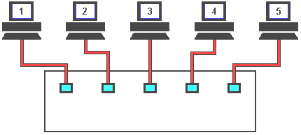
Full-Duplex Transmission
To overcome the problem of collisions and other effects on network speed, a switch is used.
With a switch, machines can transmit simultaneously
Notes:
As you can see, the switch reads the destination addresses and 'switches' the signals directly to the recipients without broadcasting to all of the machines on the network. This 'point to point' switching alleviates the problems associated with collisions and considerably improves network speed.
In the real world however, one or more of these machines will be servers, and as most network traffic is between the clients and a server a serious bottle neck can occur. The answer to this problem is to make server connections faster than the clients. The normal solution is to have the client machines on 10Mbs ports and the servers on 100Mbs ports. This ten to one ratio is usually adequate because not all of the clients will need to access the servers at the same time.

Slide 28
Devices Used in Networking
Networking Devices
  Repeater
  Hub
  Bridge
  Switch
Internetworking Devices
  Router

Slide 29
Devices Used in Networking
Repeater
  A repeater is an electronic device that receives a weak or low-level signal and retransmits it at a higher level or higher power, so that the signal can cover longer distances without degradation.
  Can connect computers that are far from each other
  Operate at the physical layer of OSI/RM

Slide 30
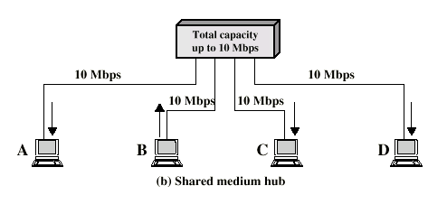
Devices Used in Networking
Hubs
  Operate at the physical layer of OSI/RM
  Hub retransmits incoming signal to all outgoing lines
  Only one station can transmit at a time
  With a 10Mbps LAN, total capacity is 10Mbps

Slide 31
Devices Used in Networking
Bridges
  A network bridge connects multiple network segments at the Data Link Layer.
  Network bridges filter frames to determine whether a specific frame belongs on a local segment or another LAN segment
  Use hardware address to determine which segment will receive the frame
  Operate at the layer 2 of OSI/RM
  Reduce network traffic
  Connect network segments with same or different DLL protocol
Notes:
Bridges are similar to repeaters or network hubs, devices that connect network segments at the physical layer, however a bridge works by using bridging where traffic from one network is managed rather than simply rebroadcast to adjacent network segments.

Slide 32
Devices Used in Networking
Switches
  A device that connects PCs in star configured networks
  Faster than hubs and bridges
  Benefits:
    Simple installation
    Higher speed
    More server bandwidth
  Can operate at several layers of OSI/RM
  Each device has dedicated capacity equal to the LAN capacity

Slide 33
Devices Used in Networking
Layer 2 switch
  LAN switch
  Forwards traffic based on the MAC address
Layer 3 switch
  Routing switch
  Forwards traffic based on IP Address
  Used for Inter-VLAN routing
  Don’t have WAN connectivity

Slide 34
Bridging vs. LAN Switching
Bridges are software based, while switches are hardware based because they use ASIC chips to help make filtering decisions.
Switches have a higher number of ports than most bridges.
Both bridges and switches forward layer 2 broadcasts.
Bridges and switches learn MAC addresses by examining the source address of each frame received.
Both bridges and switches make forwarding decisions based on layer 2 addresses.

Slide 35
Devices Used in Networking
Routers
  A device that connects any number of LANs.
  Used to redirect packets between networks
  Use headers and a forwarding table to determine where packets go.
  Use network layer address ( IP Address)
  Operate at the network layer of OSI/RM

Slide 36
Thank you

